Slide 1

RxJs Observables and HttpClient
Curs 6:

Slide 2
Evolution of Asynchronous
JavaScript
Callbacks
Promises
Async/await
Observables

Slide 3
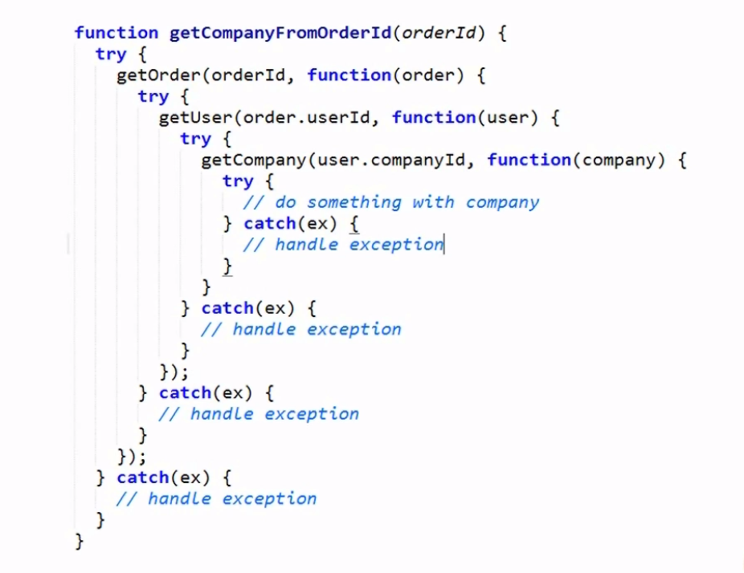
Calback function

Slide 4
Promises
What is a Promise?
“A promise is an object that may produce a single value some time in the future”
“A promise is a special kind of javascript object which contains another object”
A promise may be in one of 3 possible states: fulfilled, rejected, or pending.
Ex:
const wait = time => new Promise((resolve) => setTimeout(resolve, time));
wait(3000).then(() => console.log('Hello!')); // 'Hello!'

Slide 5
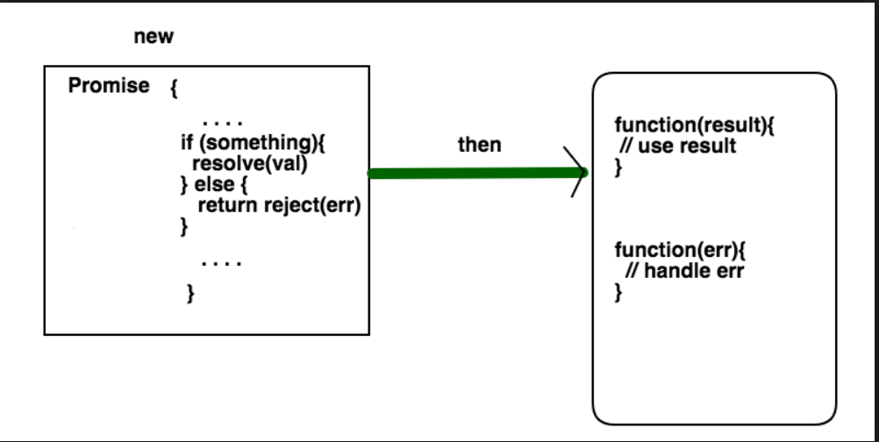
Promise

Slide 6
Async/await
Introduced in ES7
Under the hood async functions using Promises → return a Promise

Slide 7
What is RXJS ?
“Reactive Extensions for JavaScript (RXJS) is a reactive streams library for buildng ansynchronous applications with observable sequences”
RxJS can be used both in the browser or in the server-side using Node.js
Basically RxJS helps you observe the events that happen in a stream and react to them accordingly.

Slide 8
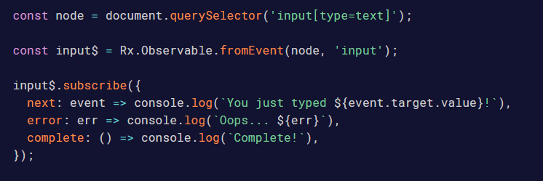
Observables
An Observable is just a function, with a few special characteristics.
These are that it takes in an "observer" (an object with "next", "error" and "complete" methods on it), and returns cancellation logic.

Slide 9
Observer
An observer is quite simple, in the above example the observer is the object literal we pass into our .subscribe()
The observer is actually your object literal with next(), error() and complete() on.
.subscribe(next, error, complete) is also valid syntax

Slide 10

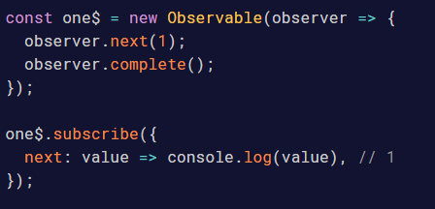
How does it work
Simple Observable constructor
subscribe: a function defining the internal behavior of our observable aka What are we observing.
The subscribe function takes a function as a parameter, an observer
The observer reacts to the emitted values. Or simply put, his "next", "complete" and "error" functions get called.

Slide 11
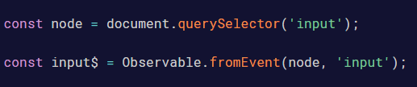
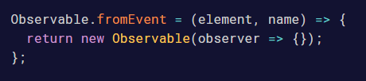
What about fromEvent?
Another function, takes the element and the name of the event
We are expecting an Observable from this function, lets add it
Ok, we are building an Observable, but what is the source of emissions?

Slide 12
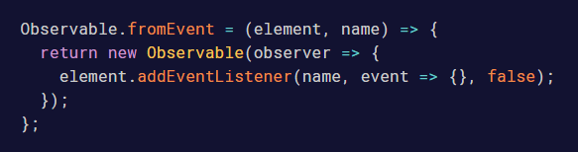
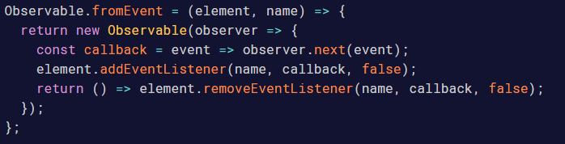
What about fromEvent? Cont
Our source will be an event listener
Here is the interesting piece. The observer is never passed through until .subscribe() is invoked.
This means the addEventListener is never "setup" by our Observable until it’s subscribed to.
Need the cancellation logic.

Slide 13
HttpClient
Import the module : import { HttpClientModule } from '@angular/common/http';
Inject HttpClient into constructor: constructor(private http: HttpClient) {}
Start making http calls:

Slide 14
References
Observables:
https://ultimatecourses.com/blog/rxjs-observables-observers-operators
https://angular.io/guide/observables
HttpClient:
https://angular.io/guide/http

